Slide 1


Budgeting for Your School Parent Involvement Program (7E046)
2015-2016
Notes:
Welcome

Slide 2

2
OBJECTIVE
To provide guidance to schools for
the development and approval of
categorical budgets and for the
alignment of Title I parent
involvement funds to Appendix B
program guidelines
Notes:
We have one major objective with a few parts to it: We would like to remind you of the development and approval requirements for categorical budgets

Slide 3
RESEARCH
3
When parents are involved in supporting student learning at home and at school, students have…
higher grades, test scores and graduation rates
better school attendance
increased motivation
higher self-esteem
fewer suspensions
less drug use
less alcohol use
less violent behavior
Notes:
Why does LAUSD believe it is important for families to be our partners in the work of improving student achievement? It’s the research. Research shows that when parents are involved… [Read slide & click twice]
This strong parent involvement research supports our beliefs in LAUSD.

Slide 4

4
LAUSD’s CORE BELIEFS
Every LAUSD student will receive an education in a safe, caring environment, and every student will be college-prepared and career-ready.
Start with students
Families are our partners
Success is in the classroom
Diversity is our strength
Effective teaching, leadership, and accountability are the keys to our success
Notes:
We in LAUSD believe that families are our partners in the work that we do to impact student achievement.

Slide 5

5
LAUSD GOALS
1. 100 % Graduation
2. Proficiency for All
3. 100 % Attendance
4. Parent and Community Engagement
5. School Safety
Notes:
Building upon the foundational belief that parents are our partners in the education of their children, LAUSD has identified Parent and Community Engagement as one of its core goals. LAUSD’s beliefs are made into action with this goal.

Slide 6
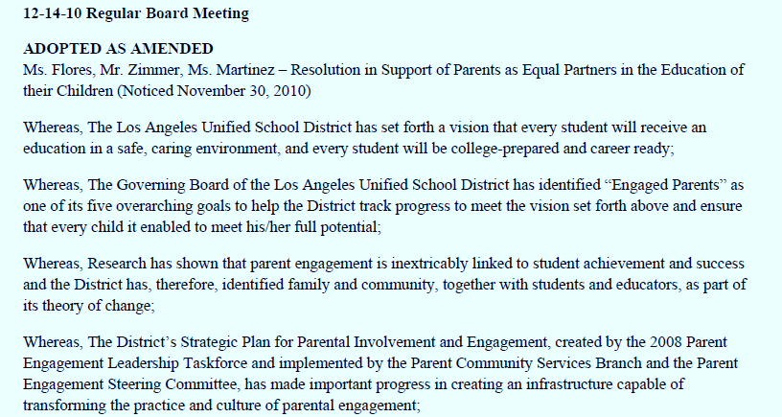
Parents As Equal Partners BOARD RESOLUTION
6
Notes:
In December of 2010, our Board of Education developed a resolution called the Parents As Equal Partners Resolution, which also highlights support for parent involvement as a goal for our District.
A Taskforce was created as a result of the Parents As Equal Partners Resolution and in December 2012 the District’s Title I Parent Involvement Policy, relying heavily on the recommendations of the Taskforce, was approved by the Board of Education.

Slide 7
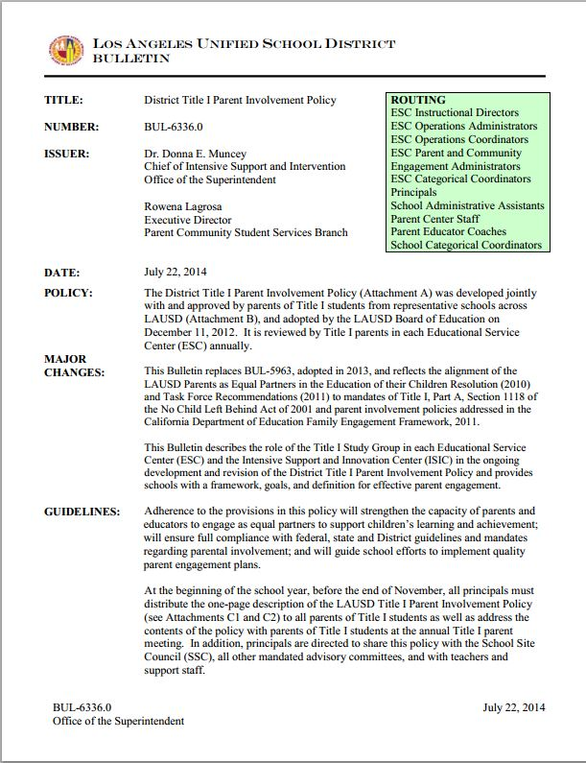
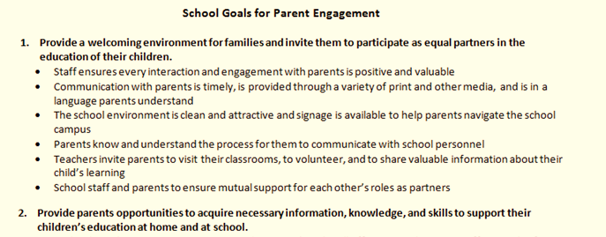
DISTRICT GOALS FOR SCHOOLS
7
5 Goals
Research-based to improve student achievement*
* Research by Joyce Epstein, Anne Henderson, Karen Mapp, among others
Notes:
So what should schools be doing to engage parents and increase parental involvement on their campuses? What schools should be doing is described in a document called “The School Goals for Parent Engagement,” found within BUL 6336.0, Attachment B of the District Title I Parent Involvement Policy [Click]. REFER TO HANDOUT. Schools should work on addressing these goals in a coordinated fashion, identifying the specific actions and strategies that they will undertake to accomplish these parent goals to meet the broader goal of improved student academic achievement.

Slide 8
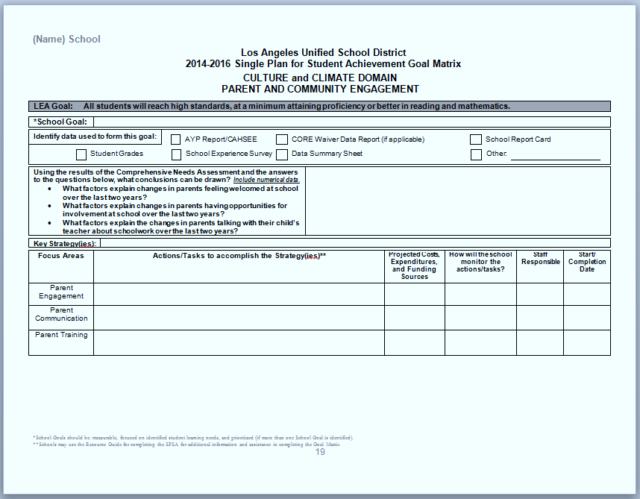
8
SCHOOL GOALS IN SPSA
Notes:
Those goals will be captured on the Single Plan for Student Achievement parent page. After doing a data-driven needs assessment, schools develop goals for parent engagement (CLICK) that relate to the District’s 5 goals for schools. Those goals are captured in the Single Plan for Student Achievement, and corresponding strategies need to address how the goals will be met. (CLICK) The actions and tasks taken to meet them fall into 3 broad categories: Parent Engagement, Parent Communication and Parent Training. (Explain the difference between the three. Engagement: activities that may be more social in nature and may be related to developing a welcoming environment. Communication: tools to facilitate communication with parents. Training: presentations or workshops focused on supporting student academic achievement.)

Slide 9
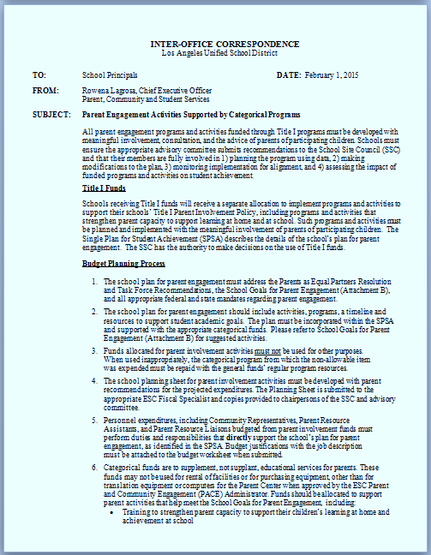

9
FUNDING FOR SCHOOL GOALS
Notes:
Appendix B of the Program and Budget Handbook for 2014 explains what can be purchased to support those goals, strategies and actions for parent engagement. With the passage of LCFF, the only mandated set-aside for parent involvement comes through federal funds, through the Title I program. Title I has funds allocated in program 7E046 to supplement the schools’ general fund dollars used for parent involvement. We have to align those supplemental funds to our SPSA parent involvement goals. So let’s look at the process for developing our budget.

Slide 10

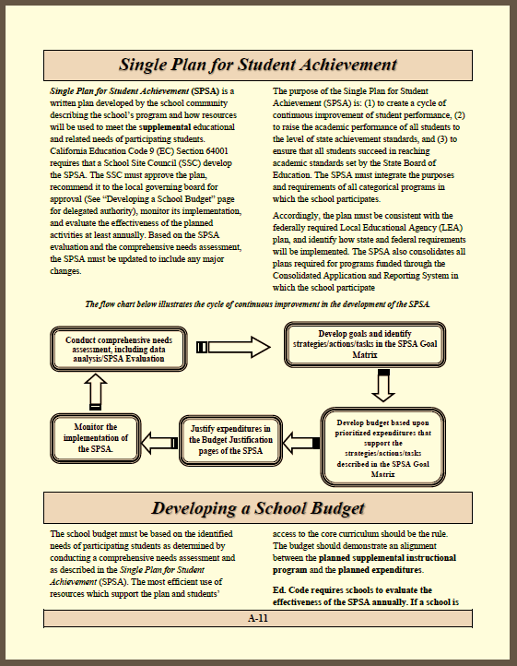
FUNDING DECISIONS
10
The School Site Council (SSC) approves the QEIA, Title I, EIA-LEP carryover funds and the budget for parental involvement (7E046).
Schools should review the Single Plan for Student Achievement with the SSC and should present all program and budget data to the SSC prior to approval. (See page A-11 and A-12, 15-16 Program and Budget Handbook)
Notes:
The process for approving budgets begins with the development and review of the Single Plan annually by the School Site Council. The School Site Council must approve of the alignment between the school’s programs for improvement and categorical budgets during “Budget Time”. Those budgets include Title I, QEIA, EIA-LEP (when it is carried over) and the budget for parental involvement. The SSC must discuss alignment of the parent involvement funds in 7E046 with program goals as stated in the SPSA. A detailed explanation of the process for the development of the SPSA and the school budget is found on pages A-11 and A-12 of the 15-16 Program and Budget Handbook found online on the Federal and State Education Program’s website.

Slide 11
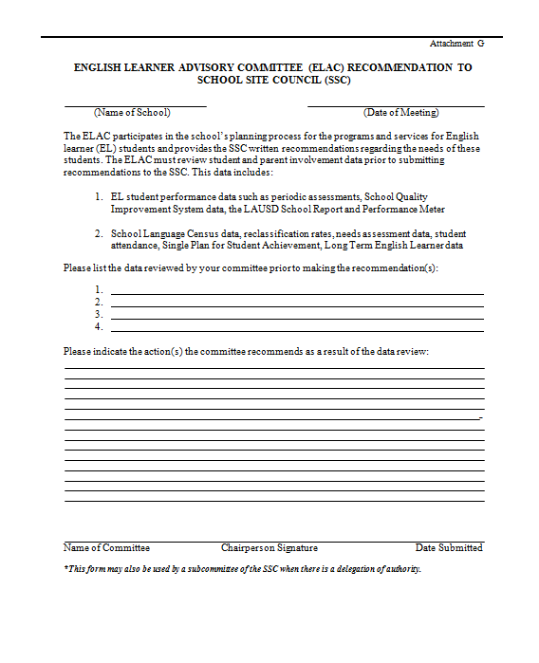
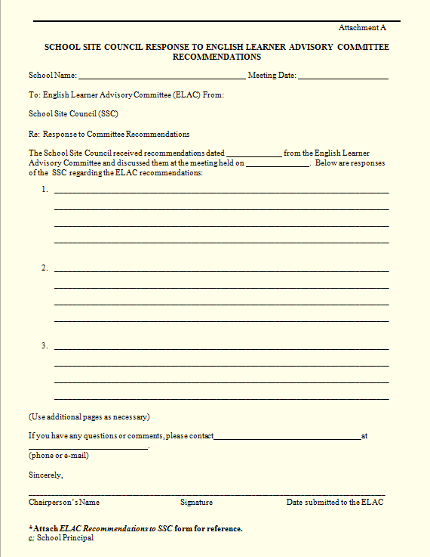
11
FORMAL RECOMMENDATIONS
Notes:
Before making budget decisions, the SSC needs a report from the ELAC on the program needs of English Learners. If the ELAC has delegated authority to the SSC, then the SSC should have the ELAC subcommittee make recommendations.

Slide 12
12
FORMAL RECOMMENDATIONS
“Functions and Responsibilities of the SSC:
b. Develop, review and adopt the SPSA in consultation with relevant stakeholders and, where applicable, with the English Learner Advisory Committee (ELAC).
c. Respond, in writing, to written recommendations from ELAC within 30 calendar days (see Attachment A).”
Bulletin 6332.0, Page 3
Notes:
Reminder, the ELAC is not making funding recommendations to the SSC. HOWEVER, the SSC is still required to receive reports on program needs for ELs when making funding decisions so that members of the SSC can make informed decisions about supporting the needs of all students. ELAC recommendations may be formal (approved by a quorum) or informal (approved by those present) if quorum cannot be achieved.

Slide 13
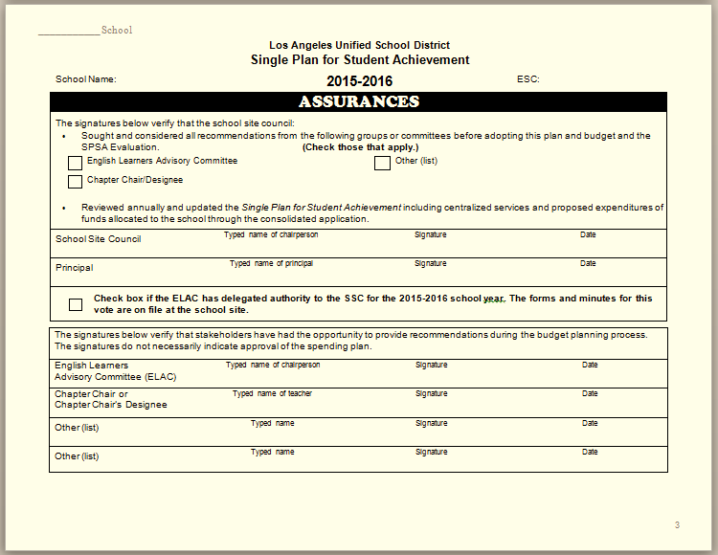
BUDGET ASSURANCES
13
Notes:
If you have an ELAC, its chairperson is supposed to sign the Assurances page of the Single Plan to show the committee was consulted. An ELAC signature does not necessarily indicate approval of the school’s spending plan. If the ELAC signature is withheld, a signed statement from the ELAC Chairperson that explains why s/he refused to sign the school’s budget assurances page must be attached to the SPSA. This information can be found on page C-3 of the 2015-2016 Program and Budget Handbook.

Slide 14
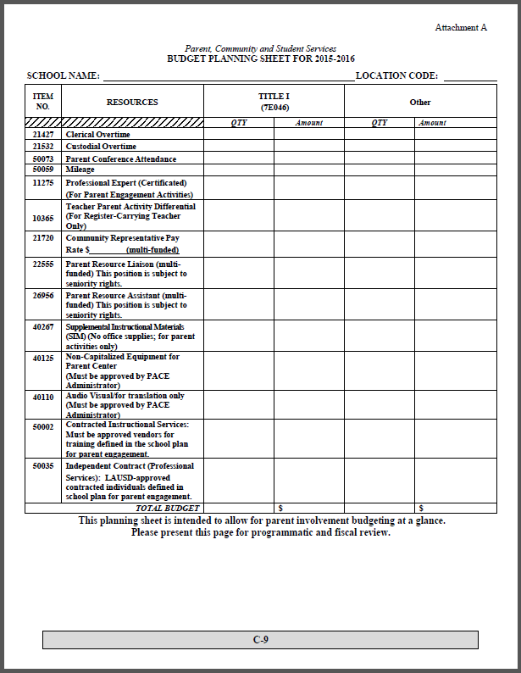
14
BUDGET PLANNING SHEET
NOTE: Parent Training Allowance has been removed. Schools cannot pay for childcare.
Computer and projection equipment for Parent and Family Centers may be purchased.
Notes:
This budget planning worksheet can be submitted to the ELAC for review. I will review some new changes to the worksheet. Please note: [Click] that the item called “Parent Training Allowance” has been removed. This item caused a lot of confusion because it was primarily used for paying for childcare, a practice that was often difficult to verify and is no longer supported by District policy. (See BUL. 6334.0)
Also note that computer and projection equipment can be purchased for parent use in the parent center, but this item is subject to approval by your PACE administrator.

Slide 15
15
BUDGET PLANNING SHEET
A differential may be provided to a register-carrying teacher only for purposes of coordinating parent engagement activities, including convening and training the school family engagement team (Partnership Action Team?) that develops the parent engagement plan. Specific duties of the teacher must be above and beyond the duties of the EL and/or Title I Coordinator.
The Instructional Materials Account has a new name! Supplemental Instructional Materials (SIM)
An SPSA Update for Supplemental Instructional Materials (SIM) must be completed for all IMA expenditures. Indicate the specific items to be purchased when completing both the justification and the SPSA Update pages.
Notes:
While this is not a new addition, I would like to emphasize that there is one expenditure that you may want to consider funding. 7E046 offers a teacher parent activity differential for teachers to coordinate parent engagement activities. Building the capacity of parents to understand the academic program is a part of all Title I Parent Involvement Policies (PIP), and providing a teacher, or more than one, with a differential to coordinate parent education and training on academic topics is one way to support this work. Work with the fiscal specialist to determine differential amount. Most schools budgeting about $1,500 per year.
Although not a new addition either, the Instructional Materials Account has changed its name to Supplemental Instructional Materials, or SIM. Don’t forget: an update needs to be done for SIM like last year!

Slide 16
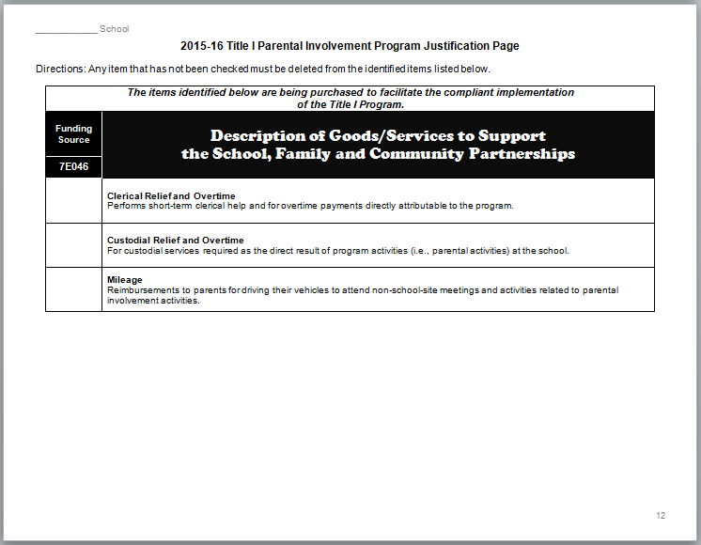
16
JUSTIFICATION PAGE
REMEMBER: Parent Training Allowance has been removed. Schools cannot pay for childcare.
Notes:
Once funding is allocated, justification pages must accompany the budget worksheet. When the justifications are standard, they are described here.
Remember, Parent Training Allowance will no longer be offered.

Slide 17
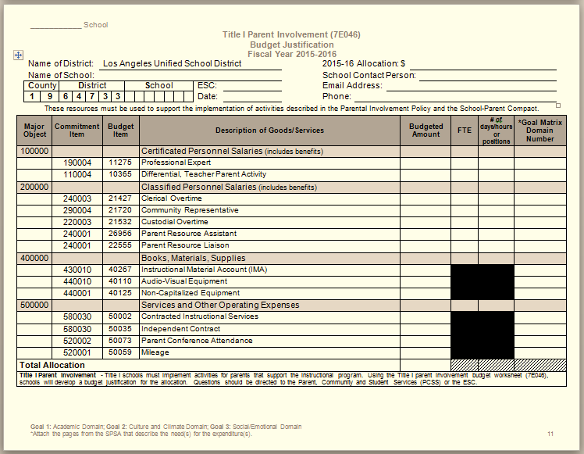
17
JUSTIFICATION PAGE
Notes:
Other budget justifications are allocated on this page. Please remember that you are allocating resources for work with parents to help them better support the instructional program.

Slide 18
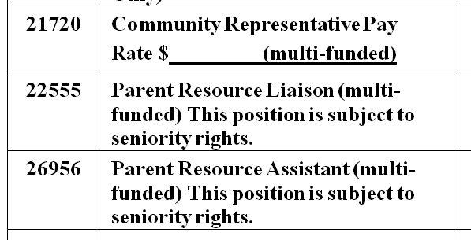
18
JUSTIFICATION FOR POSITIONS
Job descriptions for parent involvement positions can be found on the Personnel Commission website at http://achieve.lausd.net/Page/7274.
Notes:
Personnel expenditures, including Community Representatives, Parent Resource Assistants, and Parent Resource Liaisons budgeted from parent involvement funds must perform duties and responsibilities that directly support the school’s plan for parent engagement, as identified in the SPSA.
We prefer that they be multi-funded because they serve all parents, but they do not have to be.
Budget justifications with the job description must be attached to the budget worksheet when submitted. General job descriptions can be found on the Personnel Commission’s website.

Slide 19

19
BUDGET PLANNING PROCESS
Funds allocated for parent involvement activities must not be used for other purposes.
Caution!
When used inappropriately, the categorical program from which the non-allowable item was expended must be repaid with general fund regular program resources.
Notes:
Once funds are allocated, they must be used for parental involvement related to parent communication, training and engagement. A note of caution; however, [Click] when funds are used inappropriately, they must be repaid from the general fund.

Slide 20



20
ADDITIONAL RESOURCES
Notes:
There are many additional resources to assist you with the work of presenting budgets which align with the programs of your Single Plan. You can find these resources on the District’s website under the Federal and State Education Program’s page and on the Multilingual and Multicultural Education Program’s website.

Slide 21

21
QUESTIONS?

